Slide 1

COURT CONNECT
Case management made easy
Team Mavericks
Notes:
To use this title animation slide with a new image simply 1) move the top semi-transparent shape to the side, 2) delete placeholder image, 3) click on the picture icon to add a new picture, 4) Move semi-transparent shape back to original position, 5) Update text on slide.

Slide 2
Travelling Distances.
Uncertain Weather.
Backlogs and Document submission.
Non-uniform and Price discrimination by lawyers.
Overcrowding at Enquiry and court counters.
PROBLEMS

Slide 3
Don’t worry, we have it covered

Slide 4
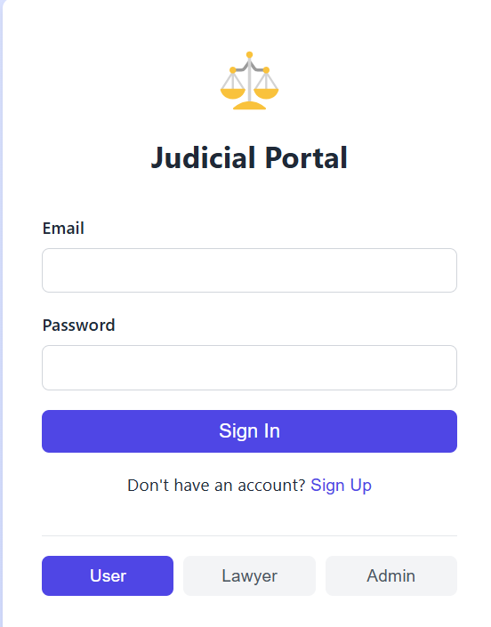
Login
Animated login page to save data of the user .

Slide 5
Enquiry
NO MORE WASTING TIME AND MONEY FOR CASE QUERIES !

Slide 6
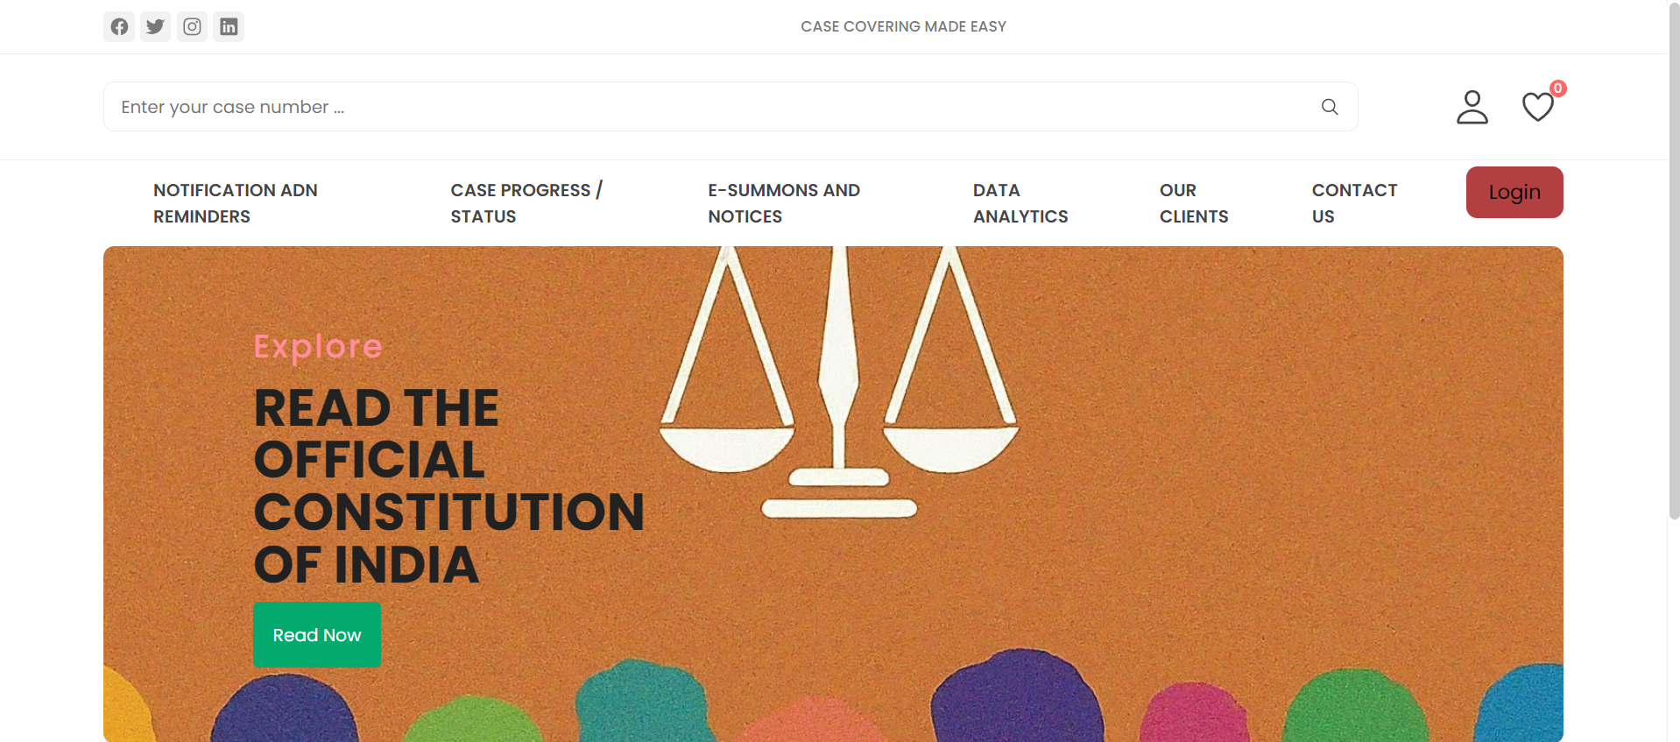
Enquiry
User creates enquiry online and registers the case on portal

Slide 7
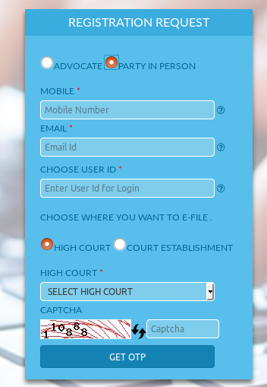
Enquiry
Admin receives enquiry about the case .
Admin responds to query and may or may not accept the case

Slide 8
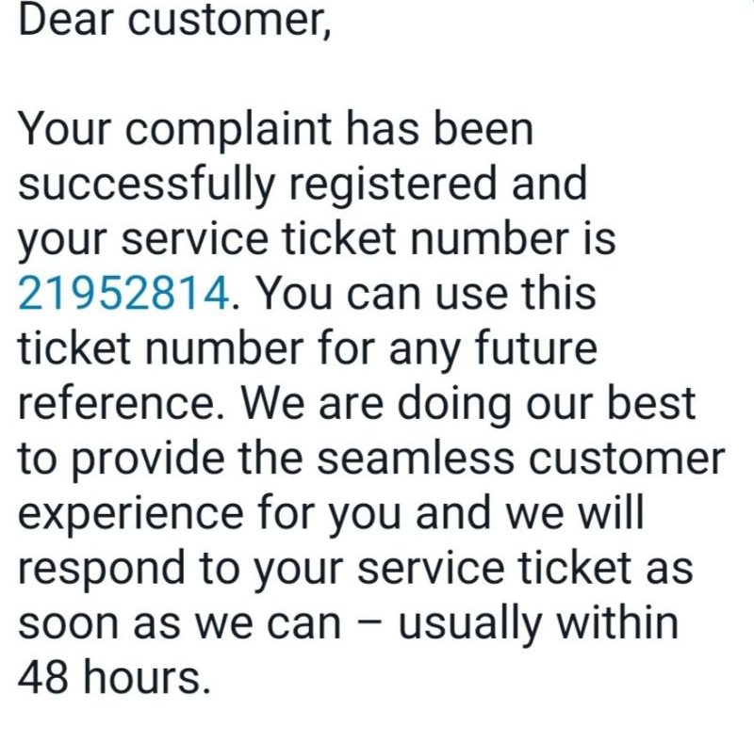
Enquiry
User receives official reply ☺

Slide 9
Announcements
USER GETS TIMELY ANNOUNCEMENT
As the judicial stake holder updates it in the dashboard , the user gets the toast of the notification and see all updates

Slide 10
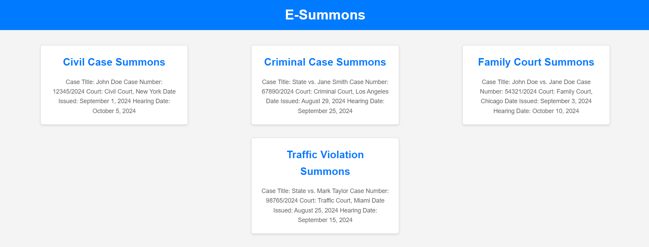
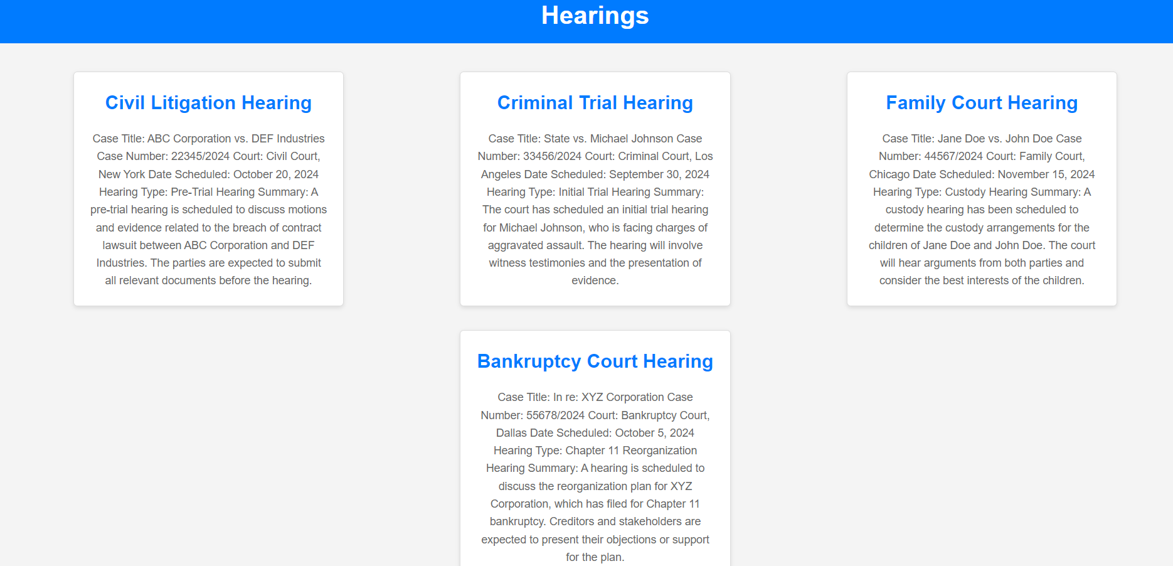
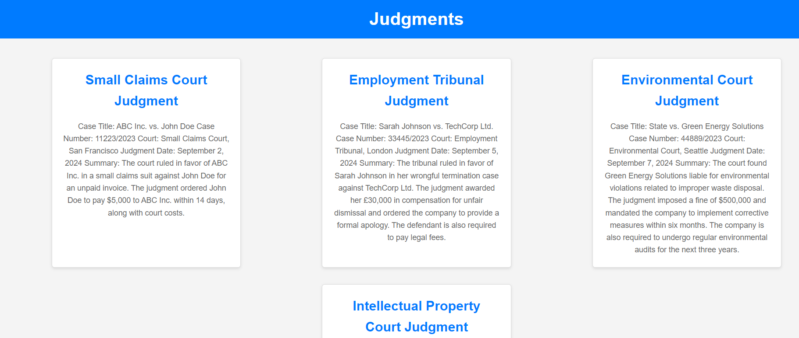
Announcements
Admin uploads announcements

Slide 11
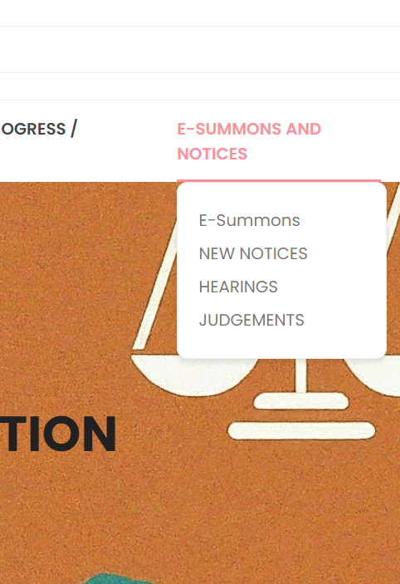
E-SUMMONS AND
NOTICES
User receives announcements on app ☺

Slide 12
E-Meet
Online virtual meeting scheduling and reminders .
Set meeting with your hired advocate and set your reminders !

Slide 13
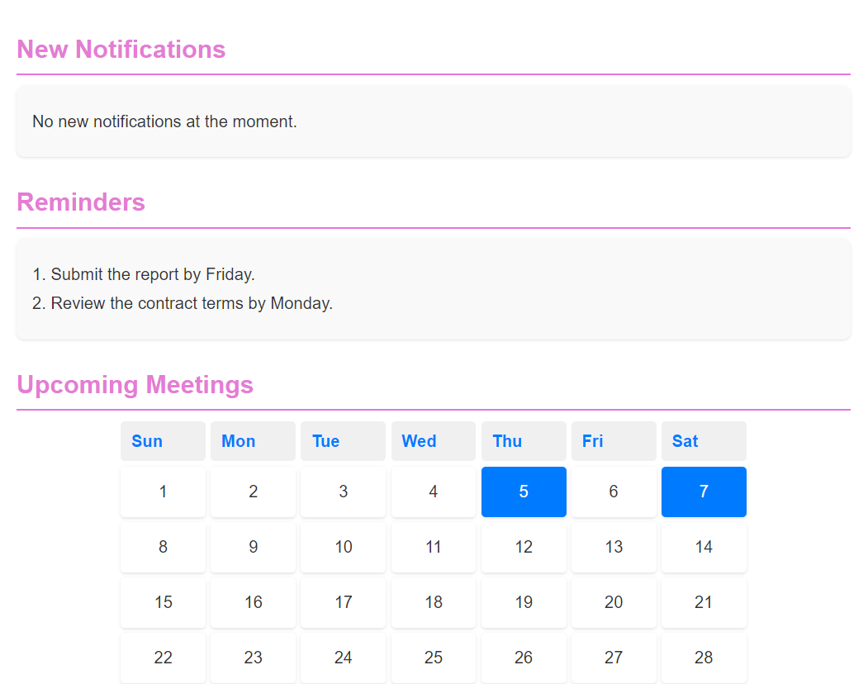
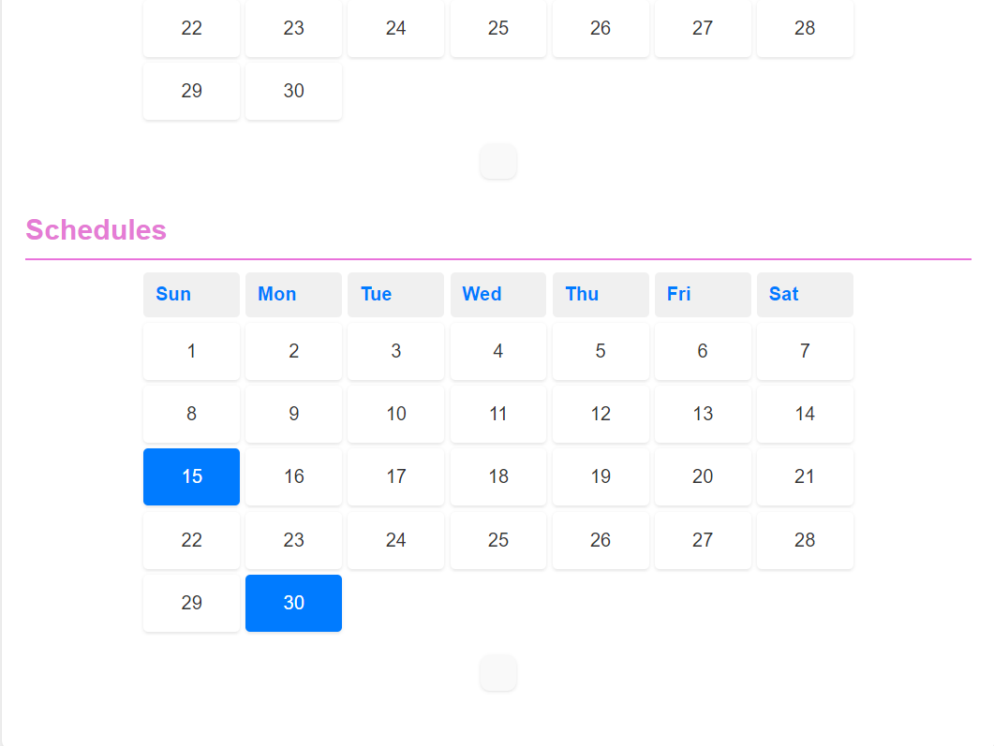
Notification
User gets the notification as updated by the law associates

Slide 14
MR. JD
Easy access of Services using CHATBOT
I can’t find my case progress and I don’t have time to contact the makers 😐
OH , wait I have Mr, JD 🤖

Slide 15
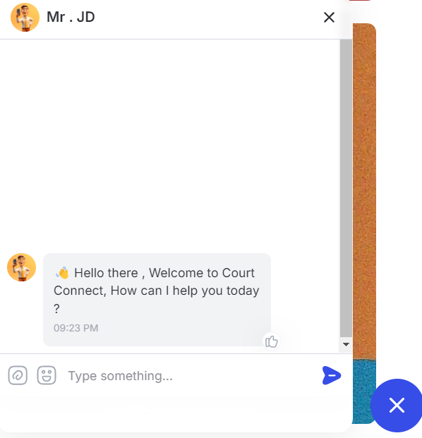
Mr. JD
Have a problem , Mr. JD got you covered . Mr. JD your personal AI web Assistant

Slide 16
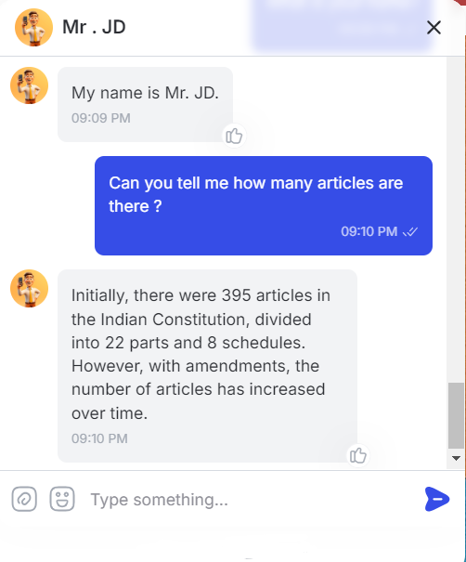
MR .JD
Enquire the bot

Slide 17
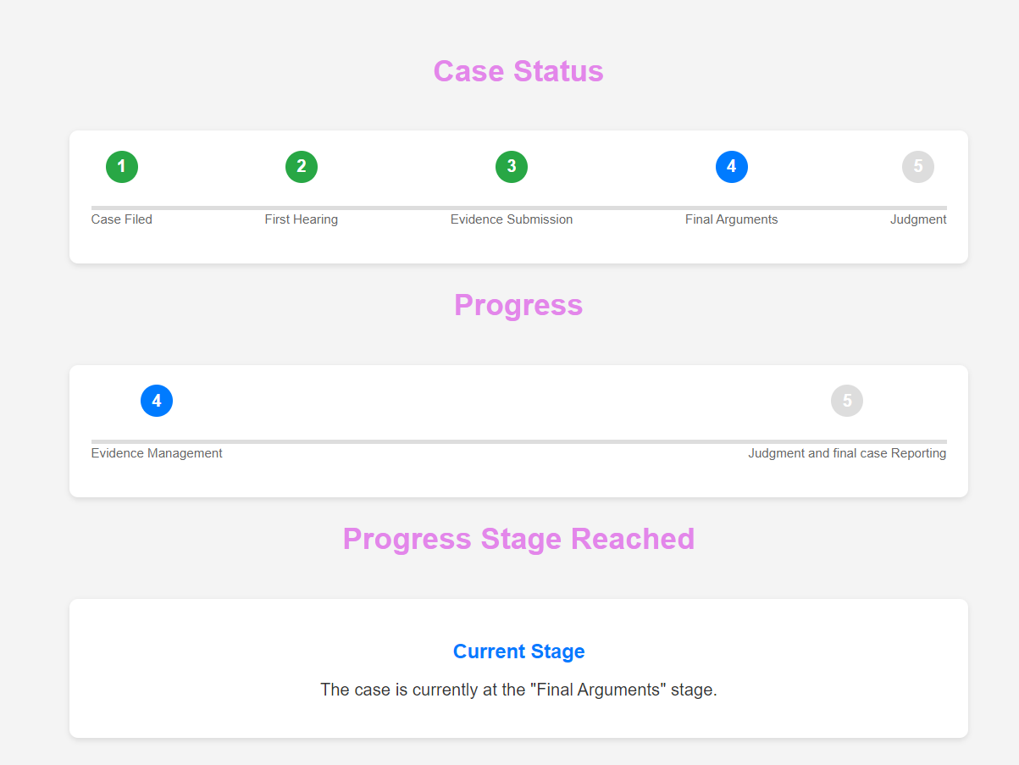
Case Progress report
Judicial stake holders report the competition stage of the case . ☺

Slide 18
Multi-Lingual
Multi Language support
Oh! man I can’t understand this 😥
Wait, I have option to convert the language ☺

Slide 19
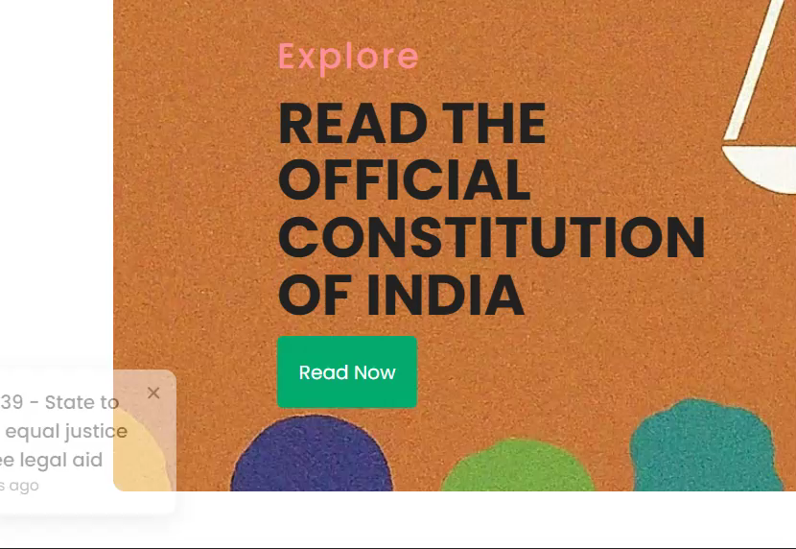
Toasts
User gets notification toast , making a fun way to learn about constitution .
Play me , I am a video 👉

Slide 20

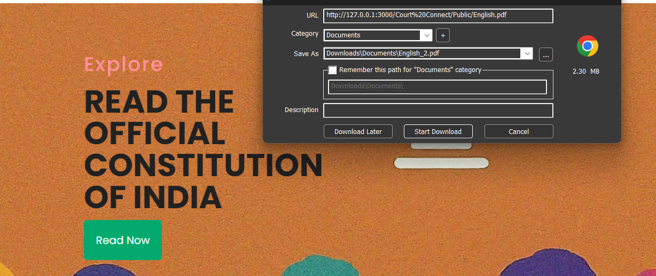
Constitution
User can read the entire constitution supported in both languages i.e. Hindi and English (Will be downloaded to device)

Slide 21
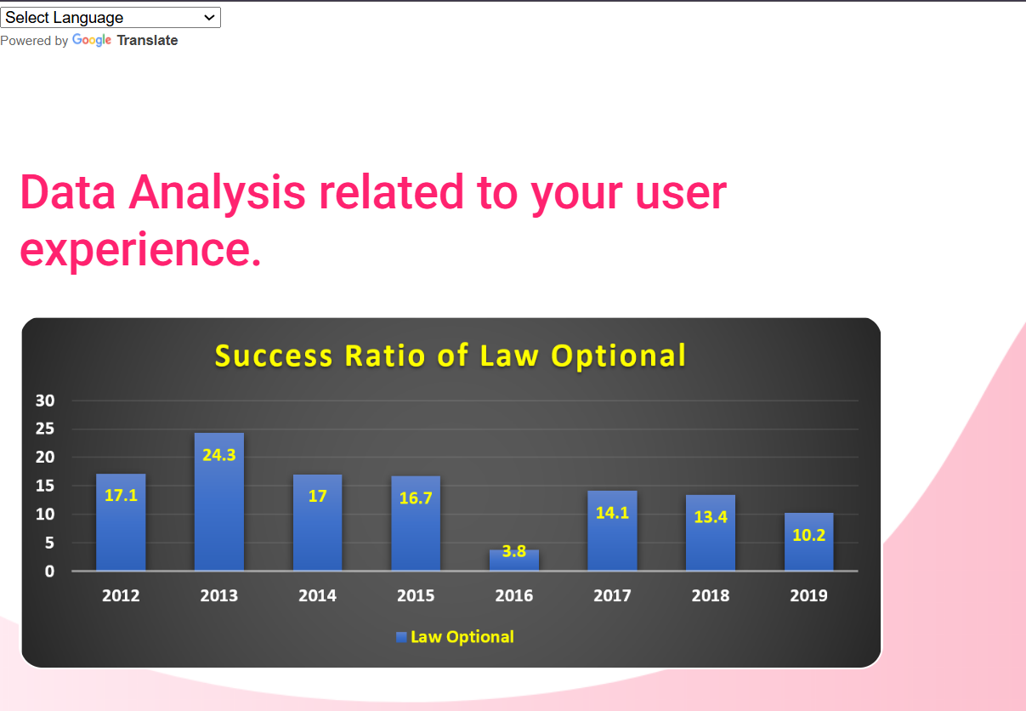
Data Analysis
Personalized data analysis based on terrain type , reports and data provided using advanced graphical models

Slide 22
Future Aspects
Fully optimized user experience ,enhanced security , and real-time monitoring of case progress and collaboration with India Law and Order . 😇

Slide 23
THANK YOU!

